Slide 1
Linear Transformers Are Secretly Fast Weight Memory Systems
李晓宇
2020.3.5

Slide 2
Background
Transformers have achieved impressive results in a myriad of sequence processing tasks
The core component of a Transformer is the self-attention mechanism. But self-attention computations scale quadratically with sequence length while the memory of the model grows linearly.
Linear Transformers. Recent work proposed “linear Transformers” with constant size memory and time complexity linear in sequence length. This complexity reduction is mainly due to a linearisation of the softmax.

Slide 3
Background
Fast Weights
Context-dependent fast weight generation was introduced in a two-network system of the early 90s (Schmidhuber, 1991; 1992; 1993) —— the slow net learns to program its fast net.
This paper relates linear Transformer to Fast Weight Memory Systems, and proposes a new update rule and a new kernel function.

Slide 4


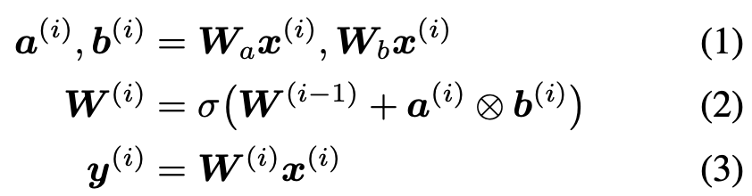
Fast Weight
Input sequence:
Output sequence:
The fast weights W (i) are generated at each time step i and serve as a short-term memory.
This is a key-value associative memory model in which the write operation is based on a summation (Eq. 2) and the retrieval is a matrix-vector multiplica-tion (Eq. 3).

Slide 5


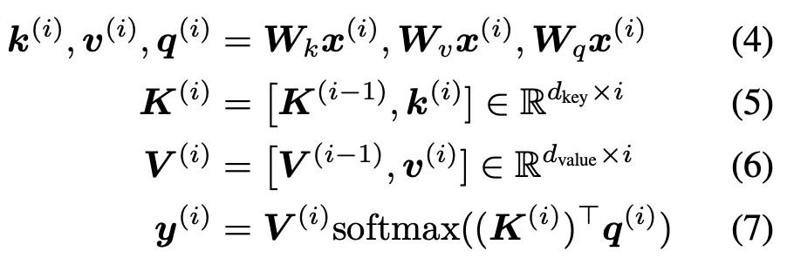
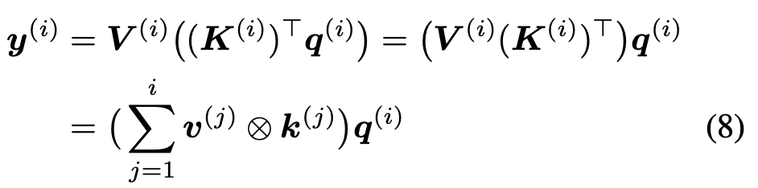
Self-Attention Without Softmax Is a Fast Weight Memory Model
where [A, a] denotes the concatenation of vector a to matrix A along the time dimension.
If we remove softmax:

Slide 6
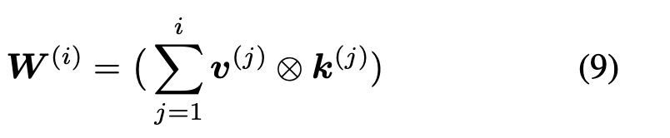
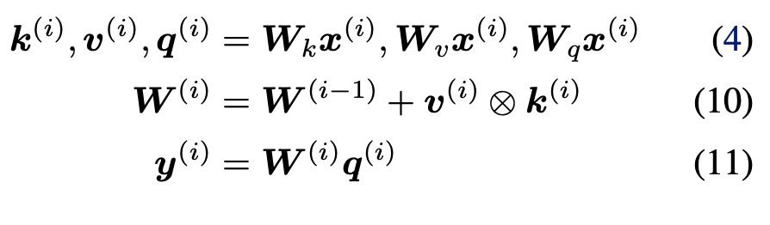
Self-Attention Without Softmax Is a Fast Weight Memory Model
Denoting by W (i) the corresponding weight matrix generated from key and value vectors:
we can rewrite Eqs. 4-7 such that they directly relate to Eqs. 1-3 where the activation function σ is the identity function and without query projection Wq:

Slide 7
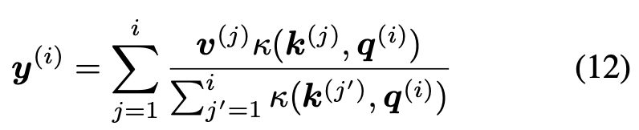


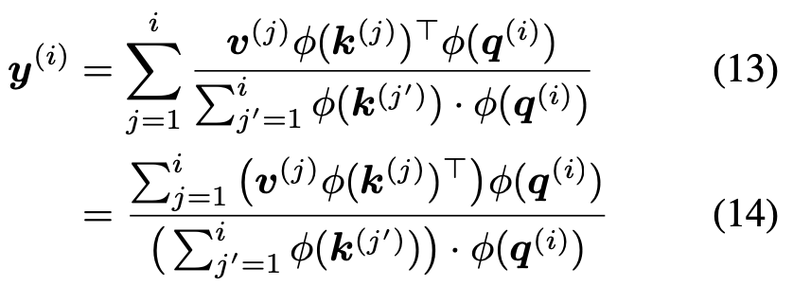
Linearising Self-Attention
Eq. 7 can be written as
The general idea is to replace the softmax kernel κ by another kernel
φ is a function

Slide 8
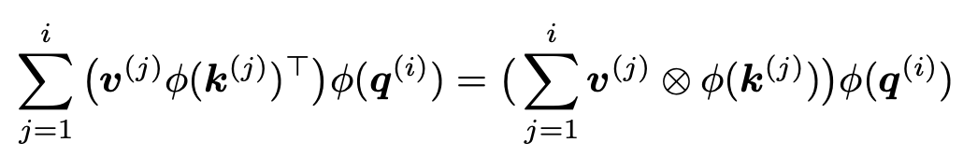
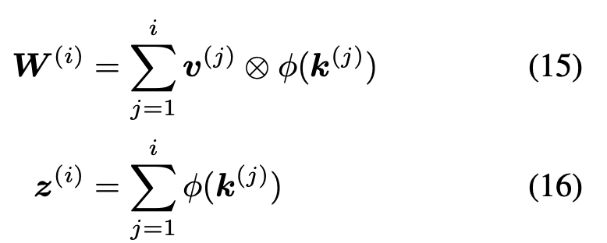
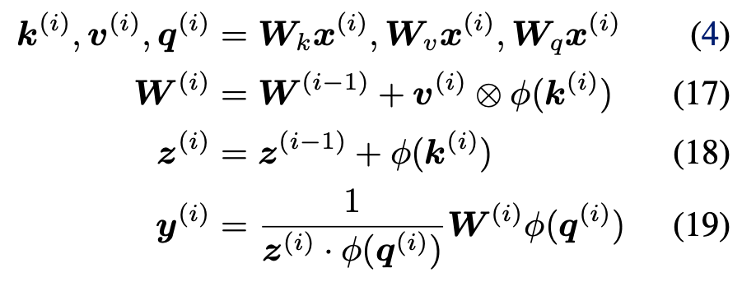
Linearising Self-Attention
Capacity Limitation

Slide 9

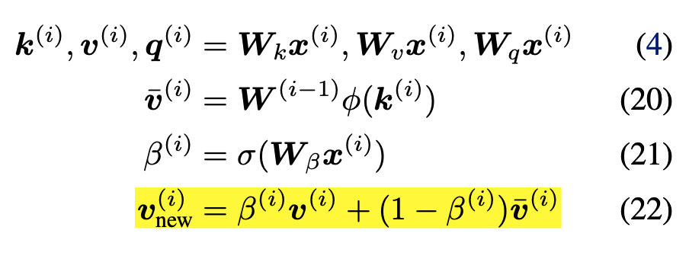
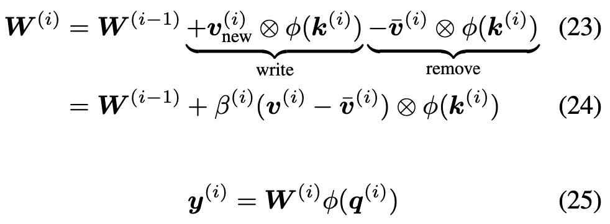
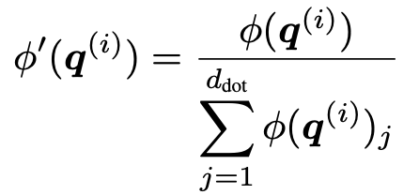
Improving the Update Rule
From the perspective of dynamic interaction with the memory, the sum update rule of Eqs. 17 may be sub-optimal.
Inspired by recent work on fast weight memories (Schlaget al., 2021) we propose the following memory update rule
Normalization:

Slide 10
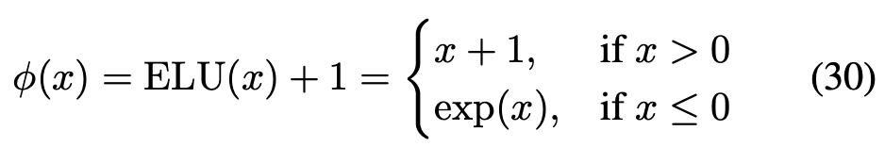
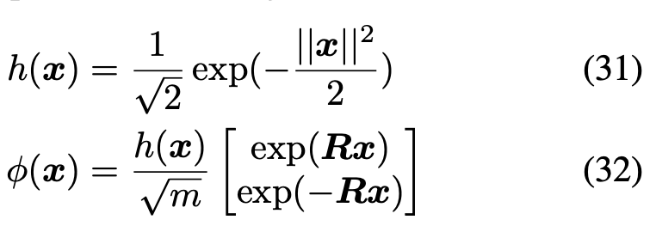


Linear Attention Functions
Properties of φ:
1. The codomain of φ should be positive.
2. By including a transformation which projects the input dimension d_{key} to a larger dimension d_{dot}, the φ
function can potentially increase the upper bound of the capacity.
Katharopoulos’ Linear Attention:
FAVOR+ (Performer)
is a matrix with m random features where each row vector r is drawn from
Choromanski K, Likhosherstov V, Dohan D, et al. Rethinking attention with performers[J]. arXiv preprint arXiv:2009.14794,
2020. (ICLR2021, Google, University of Cambridge, DeepMind, not require any properties such as low-rankness or sparsity)

Slide 11
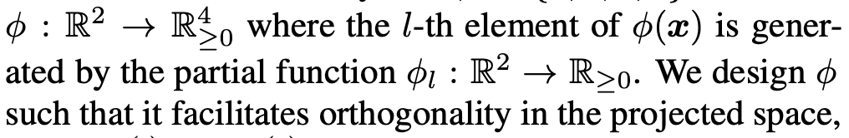
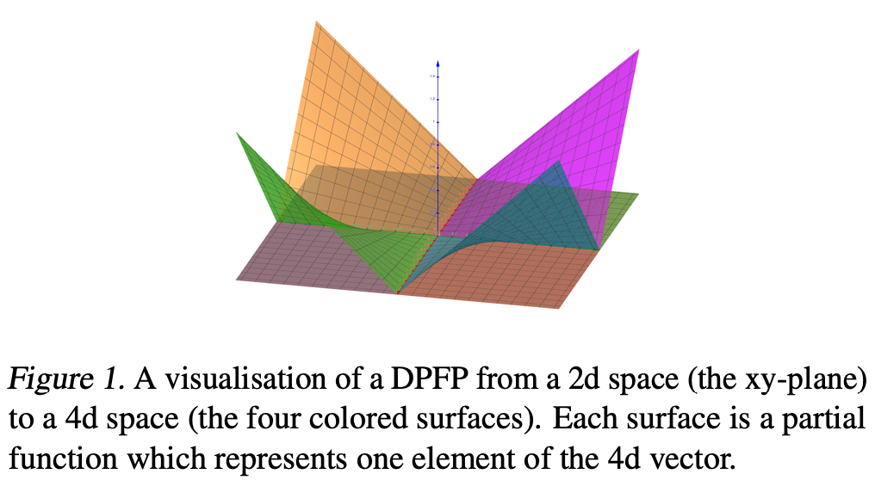

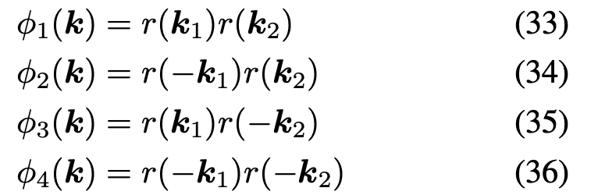
Linear Attention Functions
Deterministic Parameter-Free Projection (DPFP)

Slide 12
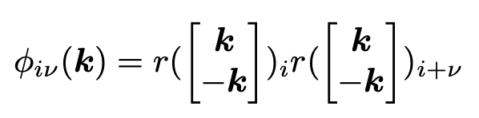




Linear Attention Functions
Deterministic Parameter-Free Projection (DPFP)
The codomain dimensionality of φ(k) is thus d_{dot} = 2d_{key}

Slide 13
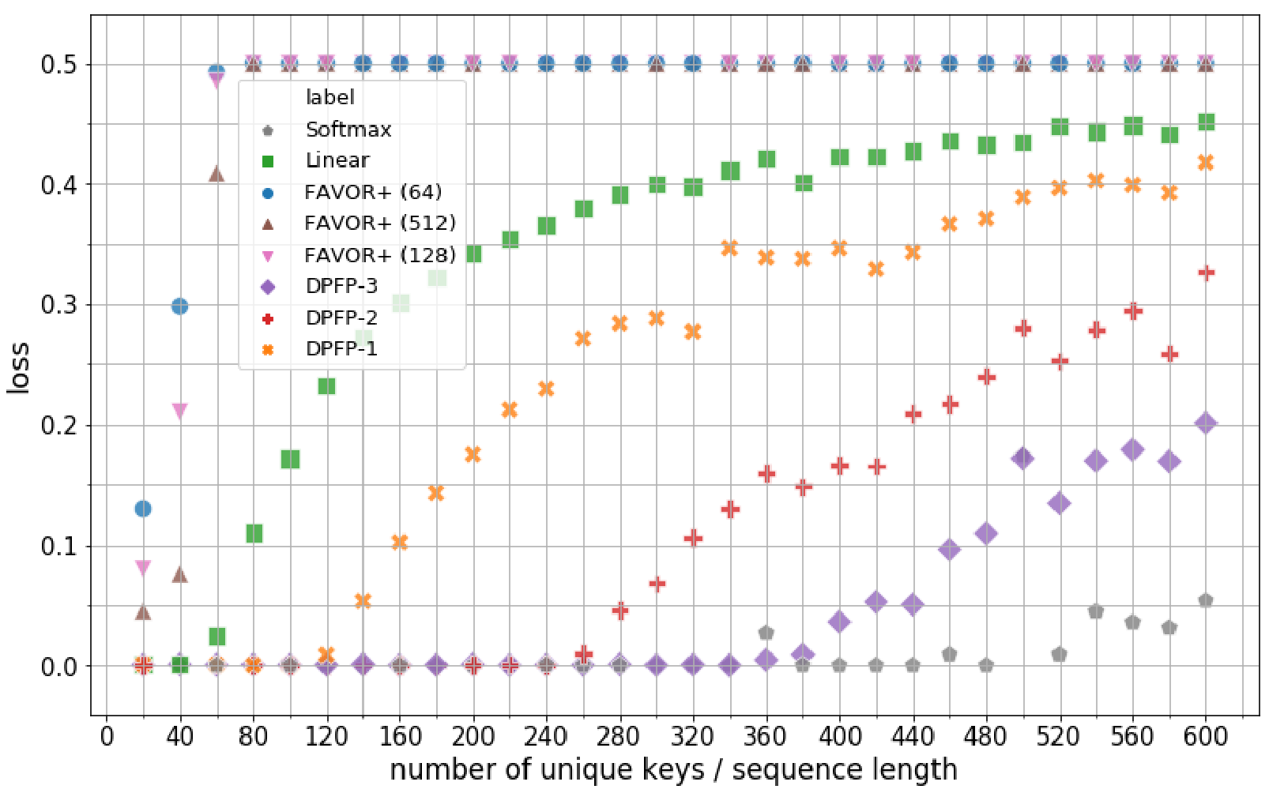
Experiments

Slide 14
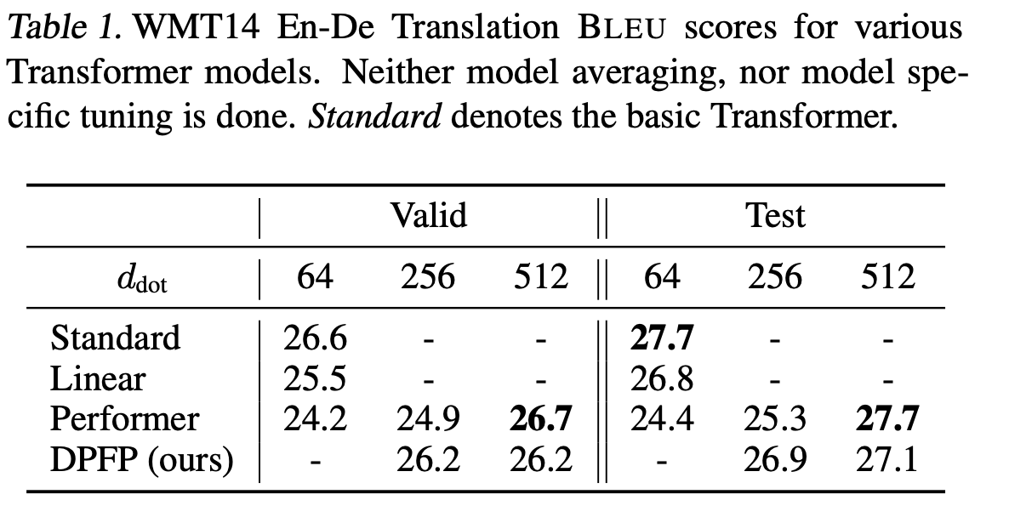
Experiments

Slide 15
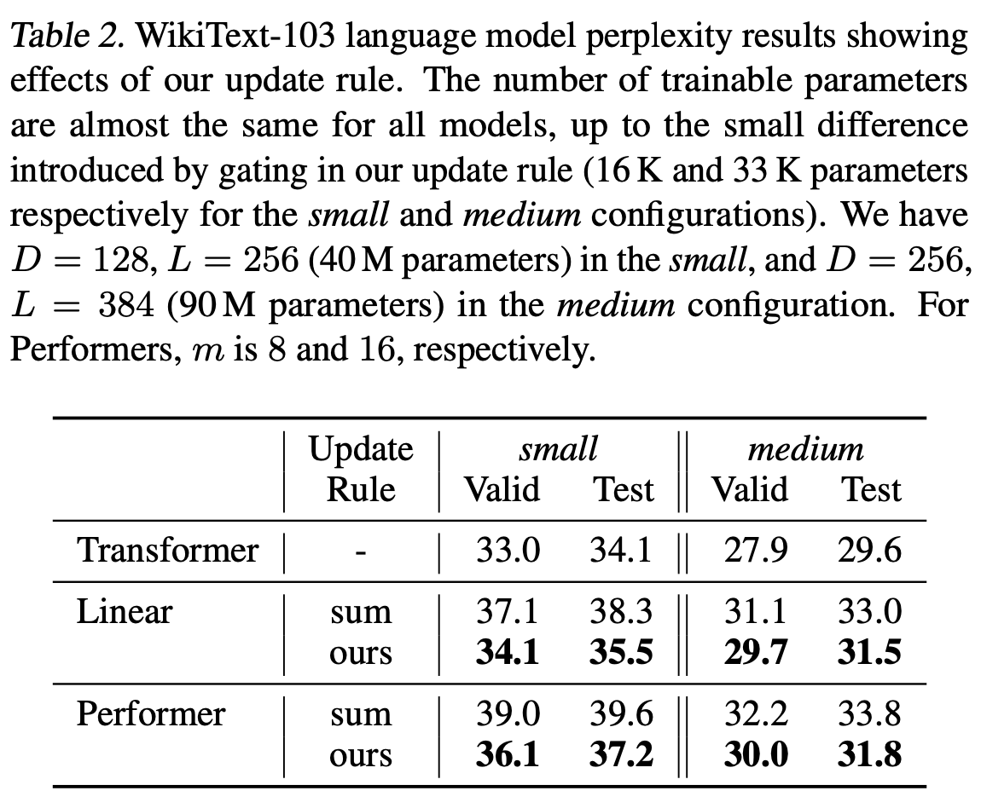
Experiments

Slide 16
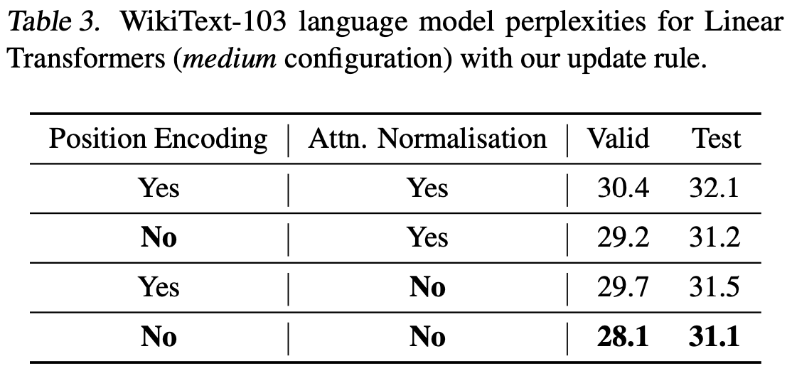
Experiments

